Slide 1

Sets
project from team
localhost

Slide 2
01
Roles
02
About the project
03
Used applications
04
Code

Slide 3
Roles
Martin Sevov
MS
 | Back End
Alexandra Laleva
AL
 | Front End
Vasil Stanchev
VS
 | Scrum Trainer
Boris Kanev
BK
 | Front End
Georgi Mihov
GM
 | Code Check

Slide 4


Used applications
 | VS
Used for the code
 | GitHub
For teamwork
About the project
We had to create a C++ program
which represents the operations
on sets realized as arrays where
the user can define the number of elements in the array, as the
elements have values you choose.

Slide 5
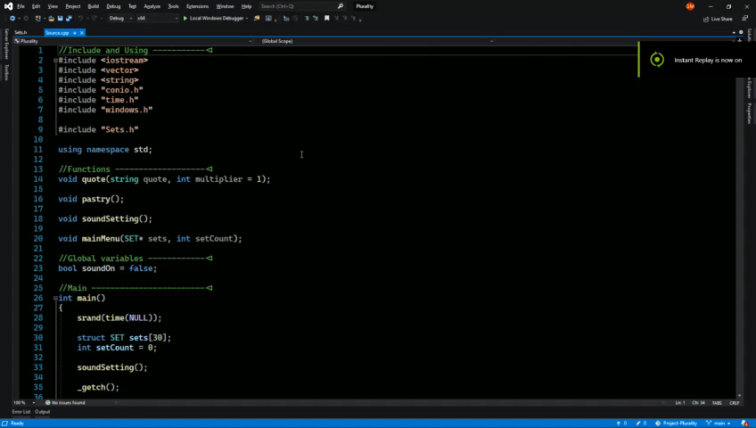
Code
The code is separated into two files:
Source.cpp, Sets.h
There are a few
Easter eggs, made
for fun ☺
In this video are
shown the functions:

